Slide 1

Error Detection
Mehek (K044), Mukund (K046), Prathamesh(K054) & Rishabh (K056)

Slide 2
Definition:
Error detection is a technique used in digital communication and data storage to identify and potentially correct clusters or bursts of errors that occur together, rather than isolated individual errors.
Key Methods:
Cyclic Redundancy Check (CRC): CRC is a widely used technique that appends a fixed-size CRC code to data. The receiver recalculates the CRC code from the received data and compares it to the transmitted CRC code to detect errors, including burst errors.
Hamming Code: Hamming codes are binary error-correcting codes that can also be used for burst error detection. They are particularly useful for detecting and correcting single-bit errors and some multi-bit errors, including burst errors.

Slide 3
Applications:
Error detection is crucial in various applications, including data storage systems, communication protocols, digital media transmission, and any scenario where data integrity is critical.
Use in Real life:
Data Transmission over Networks: In network communication, especially in wireless and satellite communications, burst error detection is essential. CRC (Cyclic Redundancy Check) is widely used in network protocols.
DNA Sequencing: In the field of bioinformatics, burst error detection techniques are applied to DNA sequencing data to identify and correct errors that may occur during the sequencing process.

Slide 4
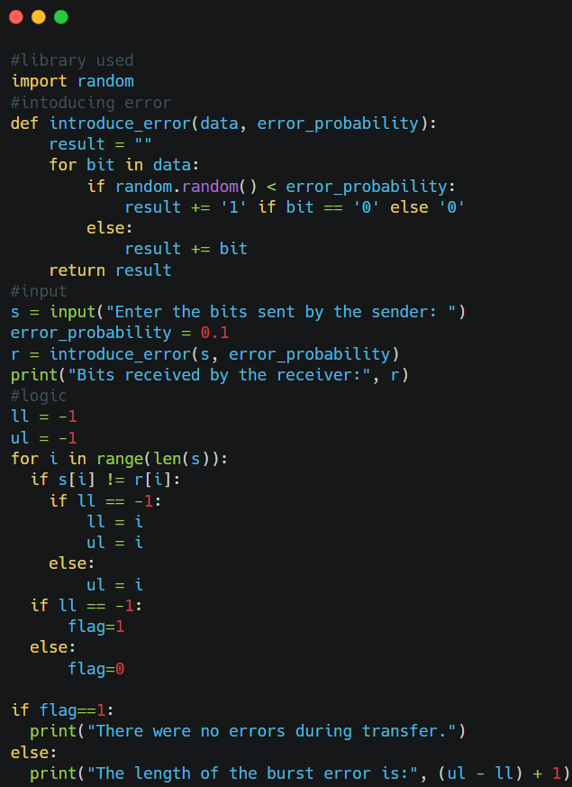
Code
Library Used: Random (for introducing error)
Introducing Errors: The introduce_error function is used to simulate errors during data transmission. It takes a string of binary data (data) and an error probability (error_probability). For each bit in the input data, it checks if a random number is less than the error probability. If it is, it flips the bit (changing '0' to '1' or '1' to '0') to simulate an error. Otherwise, it keeps the bit as it is.
Comparison with Original Data: After introducing errors, the code compares the received data r with the original data s bit by bit. It identifies the start (ll) and end (ul) positions of a burst error if any are found. A burst error is a consecutive sequence of bits that are erroneous.
Error Detection: If ll remains -1, it means no errors were detected, and flag is set to 1 to indicate that there were no errors during transfer. On the other hand, if ll is not -1, it means errors were detected, and flag is set to 0. In this case, the code also calculates and prints the length of the burst error.

Slide 5


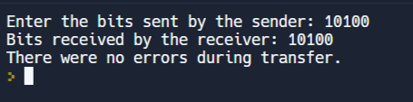
Output
Length of error 1
Length of error 6
Length of error 0

